Slide 1
LLM for Gen AI
Dr. Monali Mavani

Slide 2

Disclaimer and Acknowledgement
The content for these slides has been obtained from books and various other source on the Internet
I here by acknowledge all the contributors for their material and inputs.
I have provided source information wherever necessary
I have added and modified the content to suit the requirements of the course

Slide 3
Session Agenda
Designing systems around model intelligence
LLM-powered autonomous agent system
Agent Execution Loop (ReAct)
Multi-Agent Systems
Agent memory
Two Mental Models of an Agent
Harness engineering
Sample Case studies

Slide 4
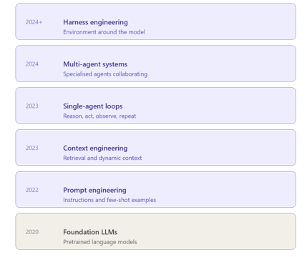
Designing systems around model intelligence
Models (mostly) take in data like text, images, audio, video and they output text. That's it.
Out of the box they cannot:
  Maintain durable state across interactions
  Execute code
  Access realtime knowledge
  Setup environments and install packages to complete work
These are all harness level features. The structure of LLMs requires some sort of machinery that wraps them to do useful work.

Slide 5
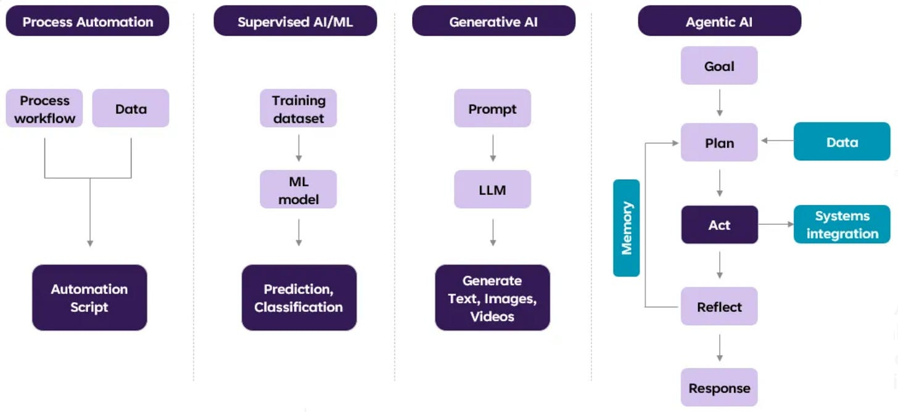
Agentic AI
Agent: term comes from reinforcement learning, where an agent is simply a function that takes an observation and returns an action.
The environment takes that action and returns a new observation, and the loop repeats.
That loop is still at the core of how LLM agents work.
In the LLM world, the term has expanded.
AI Agent as a computational entity aware of its environment and equipped with four core faculties:
cognitive abilities via an LLM
action through tool use
memory for short-term and long-term persistence of information,
and perception through multi-modal inputs.

Slide 6
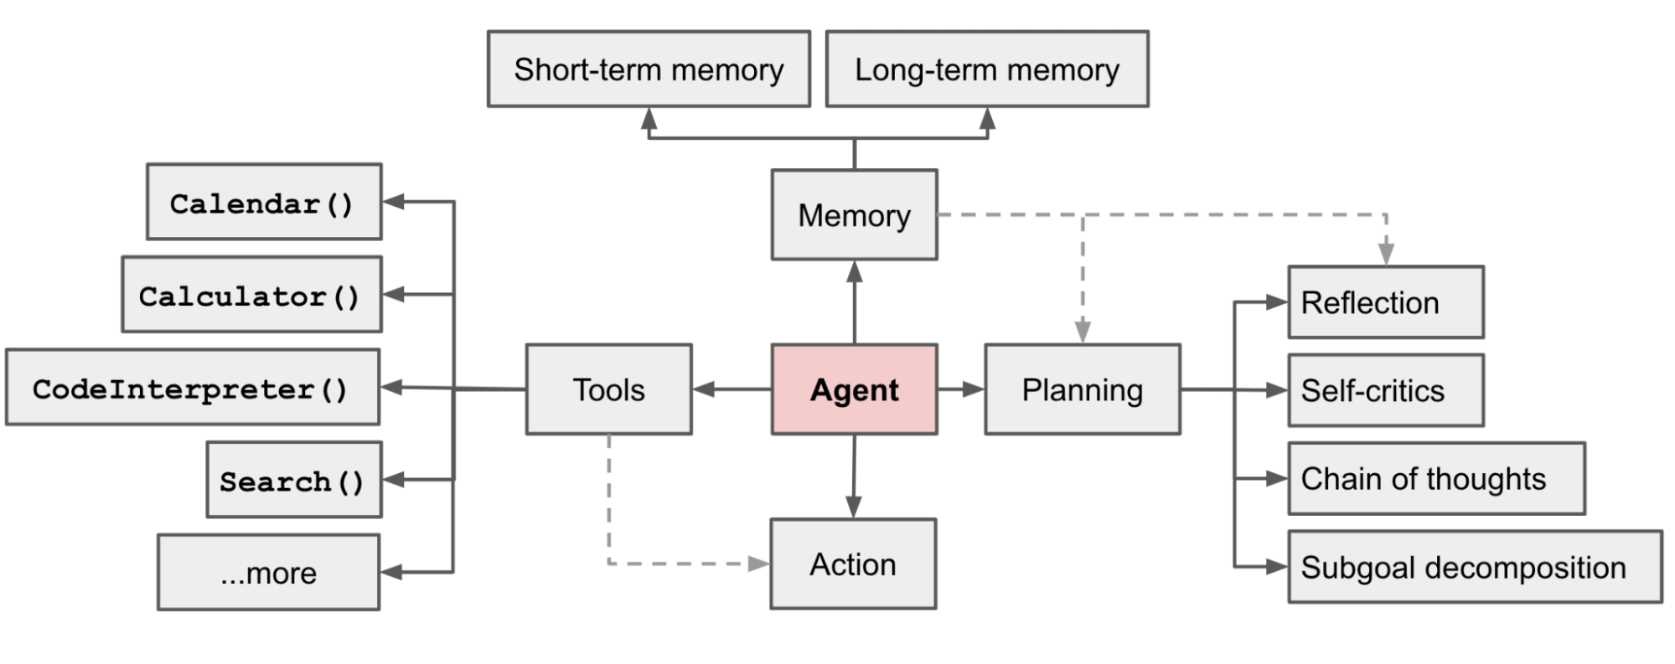
LLM-powered autonomous agent system
Augmentation view — what you add around a base LLM (Memory, Planning, Tools, Action) to turn a text generator into an autonomous agent.
                Single agent components
                Profile and Persona
              Actions and Tool Use
                Reasoning and Evaluation
                Memory and Knowledge
                Planning and Feedback

Slide 7
Agent Execution Loop (ReAct)
what agent does on a single iteration, re-using those same components on every turn until goal is met.
Perceive
Read context, memory,
goal, tool schemas
Reason
Decide the next action
from current context
Act
Invoke the selected
tool or write output
Observe
Append result;
persist what matters
Memory (read)
Planning
Tools + Action
Memory (write)
↻ repeats until the goal is met, the budget is spent, or the step cap is hit
Perceive→ Memory (read)→ Read short-term context (in-context learning), retrieved long-term memory, environment state
Reason→ Planning → Apply CoT / ToT / reflection / subgoal decomposition to pick the next action
Act → Tools + Action → Select from available tool schemas; invoke the chosen one
Observe → Memory (write) → Append tool result to context; optionally persist to long-term store

Slide 8
Modern ReAct — same skeleton, seven upgrades
Vanilla ReAct = one loop, one thought, one action
1
Structured tool calls
2
Parallel tool calls
3
Explicit planning
4
Reflection & self-critique
Native JSON schemas via bind_tools — not text parsing.
Multiple actions per turn — read 5 files, run 3 tests, fetch 4 pages concurrently.
A plan phase writes plan.md first. If step 1 is wrong, only step 1 fails.
Critic pass after each action. On failure, write the lesson to procedural memory and retry.
Branching search
Context management
Self-verification
TAKEAWAY
Modern ReAct = plan first, act in parallel, verify with tests, reflect on failure, compact as you go, persist what you learn.
5
6
7
Multiple candidate thoughts scored; backtrack from dead ends.
Compaction of old turns, tool-output offload to filesystem, progressive skill disclosure
Run the test suite after each action. Grounds solutions in truth; error becomes the next observation.

Slide 9
Multi-Agent Systems: Why & When
So far: one agent. From here on: what you build around it — multiple agents, the harness, and production guardrails.
Single-agent limit
Too many tools cause context bloat, tool confusion, higher token cost, and dropped instructions.
Specialization
Sub-agents get dedicated system prompts, distinct tool subsets, and smaller context windows.
Modularity
Isolated sub-task testing makes the system significantly easier to evaluate and debug.
When multi-agent hurts
Coordination overhead, redundant tokens, and blurred error attribution can eat the specialization gain
Prefer sub-agents when subtasks are independent and outputs are cleanly mergeable

Slide 10
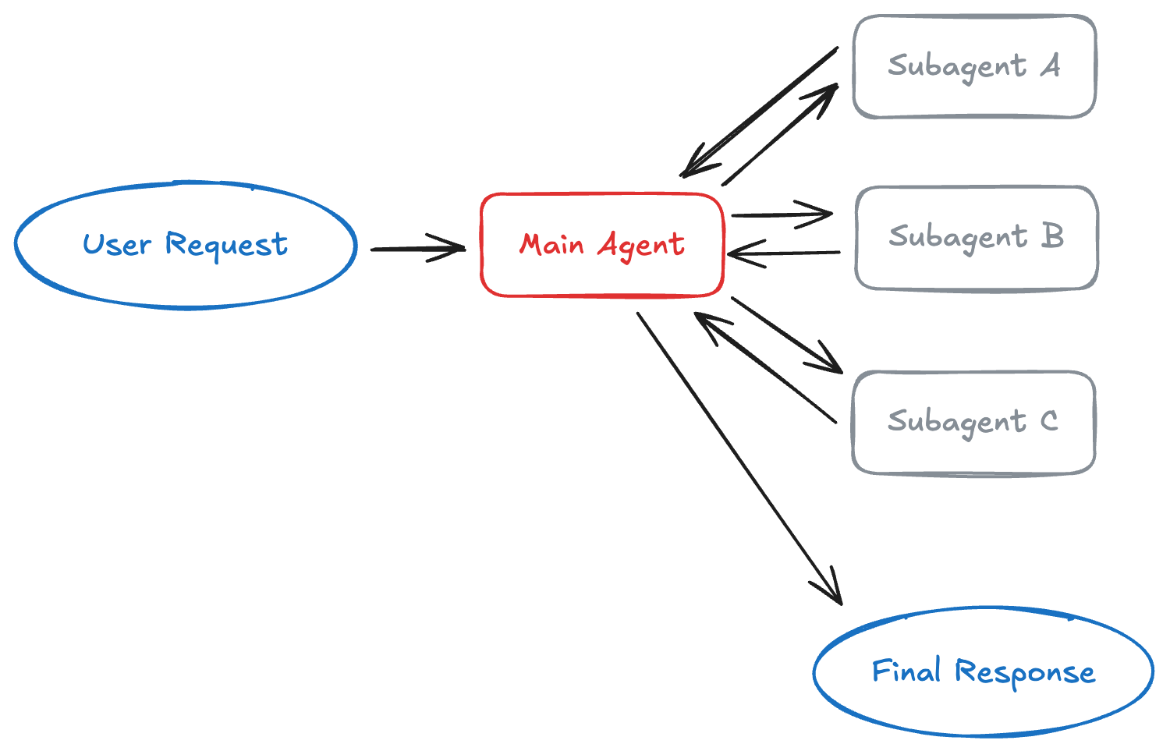
Multi-Agent Systems pattern 1
The main agent maintains conversation context while subagents remain stateless, providing strong context isolation.
How it works: The main agent decides which subagents to invoke, what input to provide, and how to combine results.
Subagents don't remember past interactions. Adds one extra model call per interaction because results must flow back through the main agent.
This overhead provides centralized control and context isolation, but costs latency and tokens.
Examples include personal assistants that coordinate calendar, email, and CRM operations, or research systems that delegate to specialized domain experts.
https://www.langchain.com/blog/choosing-the-right-multi-agent-architecture

Slide 11
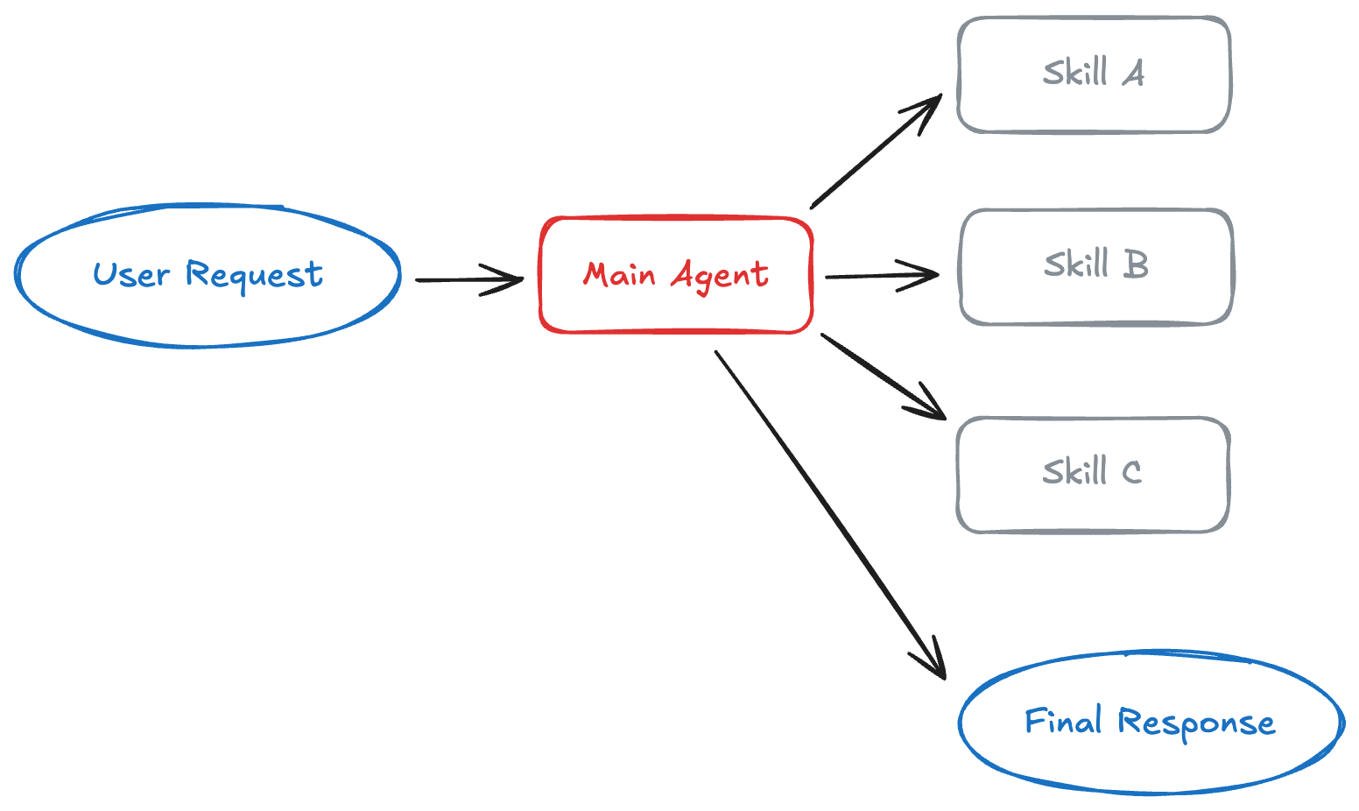
Multi-Agent Systems pattern 2 (Quasi multi-agent (progressive disclosure)
Skills: Progressive disclosure
In the skills pattern, an agent loads specialized prompts and knowledge on-demand.
How it works: Skills are primarily prompt-driven specializations packaged as directories containing instructions, scripts, and resources. At startup, the agent knows only skill names and descriptions. When a skill becomes relevant, the agent loads its full context.
Best for: Single agents with many possible specializations
Common examples include coding agents or creative assistants.
https://www.langchain.com/blog/choosing-the-right-multi-agent-architecture

Slide 12
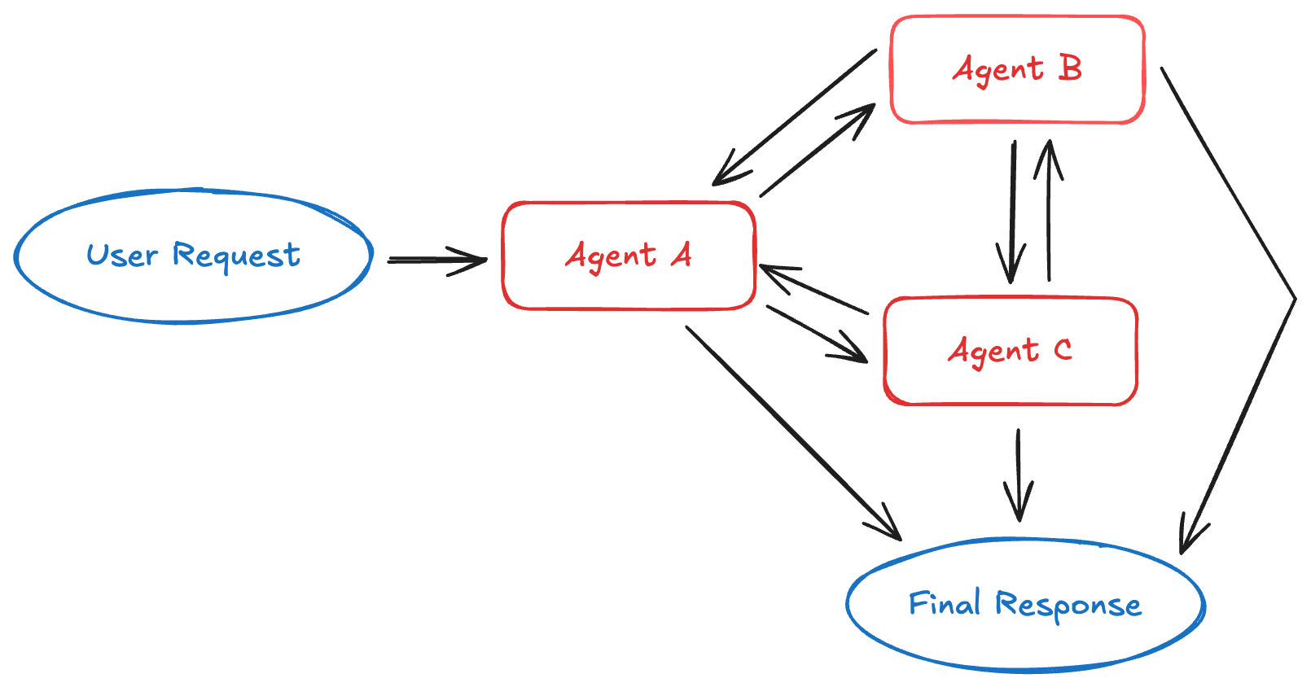
Multi-Agent Systems pattern 3
Handoffs: State-driven transitions
How it works: When an agent calls a handoff tool, it updates state that determines the next agent to activate.
This can mean switching to a different agent or changing the current agent's system prompt and available tools.
The state survives across conversation turns, enabling sequential workflows.
Best for: Customer support flows that collect information in stages, multi-stage conversational experiences, or any scenario requiring sequential constraints where capabilities unlock only after preconditions are met.
https://www.langchain.com/blog/choosing-the-right-multi-agent-architecture

Slide 13
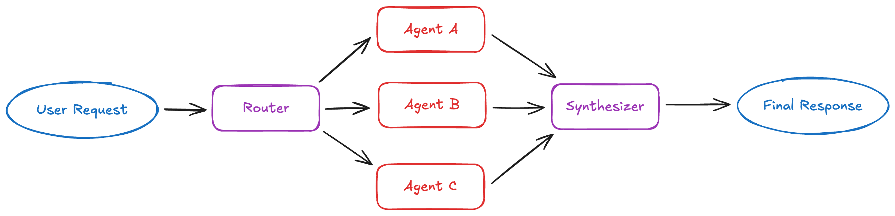
Multi-Agent Systems pattern 4
Best for: Applications with distinct verticals (separate knowledge domains), scenarios requiring queries across multiple sources in parallel, or situations where you need to synthesize results from multiple agents. Examples include enterprise knowledge bases and multi-vertical customer support assistants
Router: 1. Parallel dispatch and synthesis
2. Agent selection and no synthesis
"Router" is really a planner: it decides which subset of specialists is relevant to this particular request, dispatches those in parallel, and hands the results to a Synthesizer to merge.
The name "Router" is a LangChain convention — it's making a selection decision, but the output is a set of agents to run, not one.
https://www.langchain.com/blog/choosing-the-right-multi-agent-architecture

Slide 14
Multi-Agent Systems
our requirements | Pattern
Multiple distinct domains (calendar, email, CRM), need parallel execution | Subagents
Single agent with many possible specializations, lightweight composition | Skills
Sequential workflow with state transitions, agent converses with user throughout | Handoffs
Distinct verticals, query multiple sources in parallel and synthesize results | Router

Slide 15
How can agents communicate with each other?
Occupancy agent
?
Energy management agent
Thermostat agent
?
?
Air quality agent

Slide 16
Standardization: A2A
A2A = Agent2Agent
Occupancy agent
A2A
Energy management agent
Thermostat agent
A2A
A2A
Air quality agent
"Announcing the Agent2Agent Protocol (A2A)", Google, 2025.

Slide 17
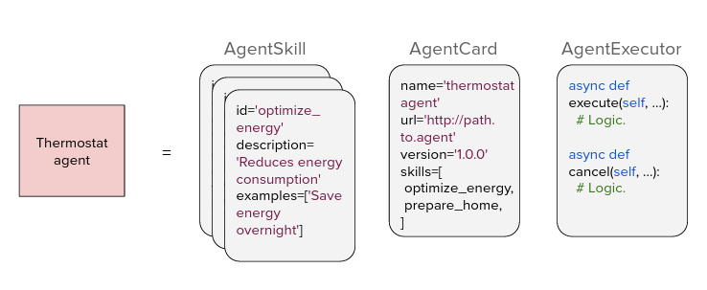
Standardization: A2A
"Agent2Agent (A2A) Protocol Oﬃcial Specification", Google, 2025.

Slide 18
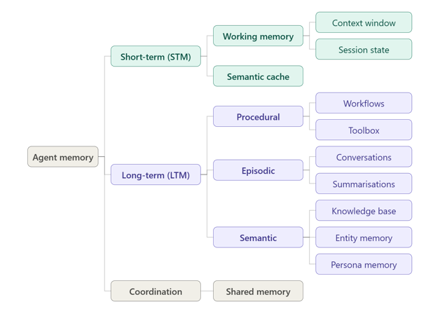
Agent memory
Cognitive architecture transforming reactive systems into intelligent agents
An agent without an augmented memory is merely a reflex agent, reacting only to the current input without learning from the previous iterations or sessions.
A memory unit can be understood as a structured container that holds not just information, but also the metadata and relationships that make that information useful for agent reasoning.
Short-term memory (STM) - Information retained for immediate use during active processing.
Long-term memory (LTM) - Information persistently stored for extended periods and future retrieval.

Slide 19
Agent memory – Short term
Working memory
  Agent's "scratchpad" for active information manipulation during a task
  It's a partitioned area in the LLM's context window or a temporary file that exists only for the duration of a session
Semantic cache
  Stores recent prompts and their corresponding LLM responses.
  When a similar query arrives, the system retrieves the cached response
  It uses vector similarity to match the semantic meaning of queries,
  E.g Customer support bot handling password resets would use a semantic cache to instantly answer the same question phrased in dozens of different ways—"I forgot my password," "Can't remember my login," or "Need to reset my account access"—all triggering the same cached response.

Slide 20
Agent memory – Long Term
Procedural Memory
  Agent's repository of learned skills, routines, decision trees, workflows, and multi-step processes. It stores the sequences of actions required to complete complex, multi-step tasks without explicit instructions.
  E.g Software deployment agent uses procedural memory to follow release protocols automatically.
Episodic Memory (autobiographical )
  Agent's record of specific events and interactions
  Common types of episodic memories include conversational and summary types, also referred to as observations.
Semantic memory
  Structured "world knowledge" that allows an agent to reason consistently.
  The most common implementation we see is for RAG systems, where vector embeddings of factual documents are stored and retrieved in a structured format.

Slide 21
Agent memory – Coordination
Shared memory
  Commonly found in multi-agent systems, enables coordination by providing a collaborative space accessible to multiple agents simultaneously.
  ACID compliance (Atomicity, Consistency, Isolation, Durability) at the database level becomes critical to prevent race conditions and ensure data integrity as multiple agents simultaneously read from and write to the shared memory space

Slide 22
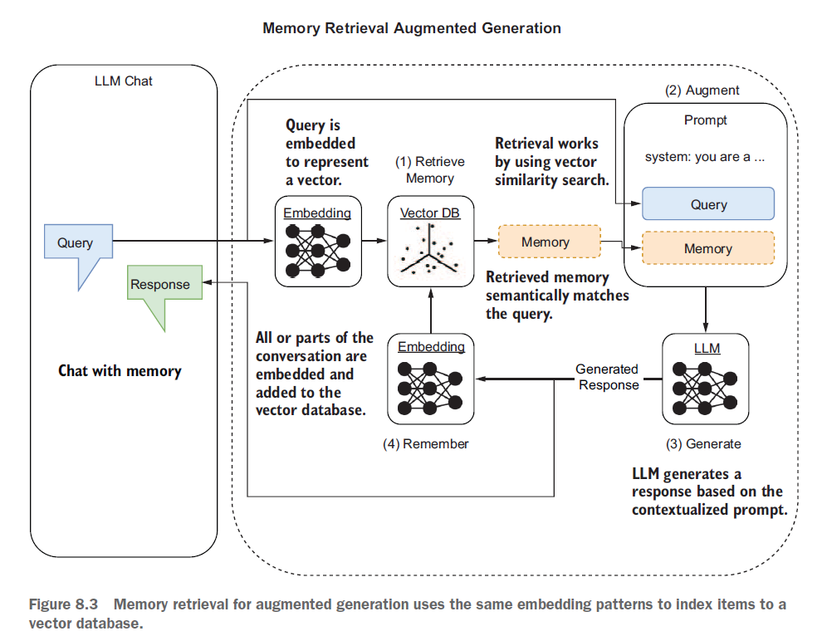

Slide 23
Two Mental Models of an Agent
Classic view (Weng 2023)
Agent = LLM + Planning + Memory + Tools
LLM as the brain; wrapped with modules for planning (CoT, ReAct), memory (short/long-term), and tool APIs.
Framing that shaped AutoGPT, BabyAGI, HuggingGPT, and the first generation of agent frameworks.
Harness view — the term is older; the framing was formalised in 2026
Agent = Model + Harness
If you are not the model, you are the harness — system prompts, tools, sandbox, filesystem, orchestration, hooks.
Views planning, memory, and tools as harness features, not separate boxes. Reflects Claude Code / Codex era.
Both compatible — the harness is how you deliver planning, memory, and tool mechanics.
Module 1 · The Agentic Shift

Slide 24
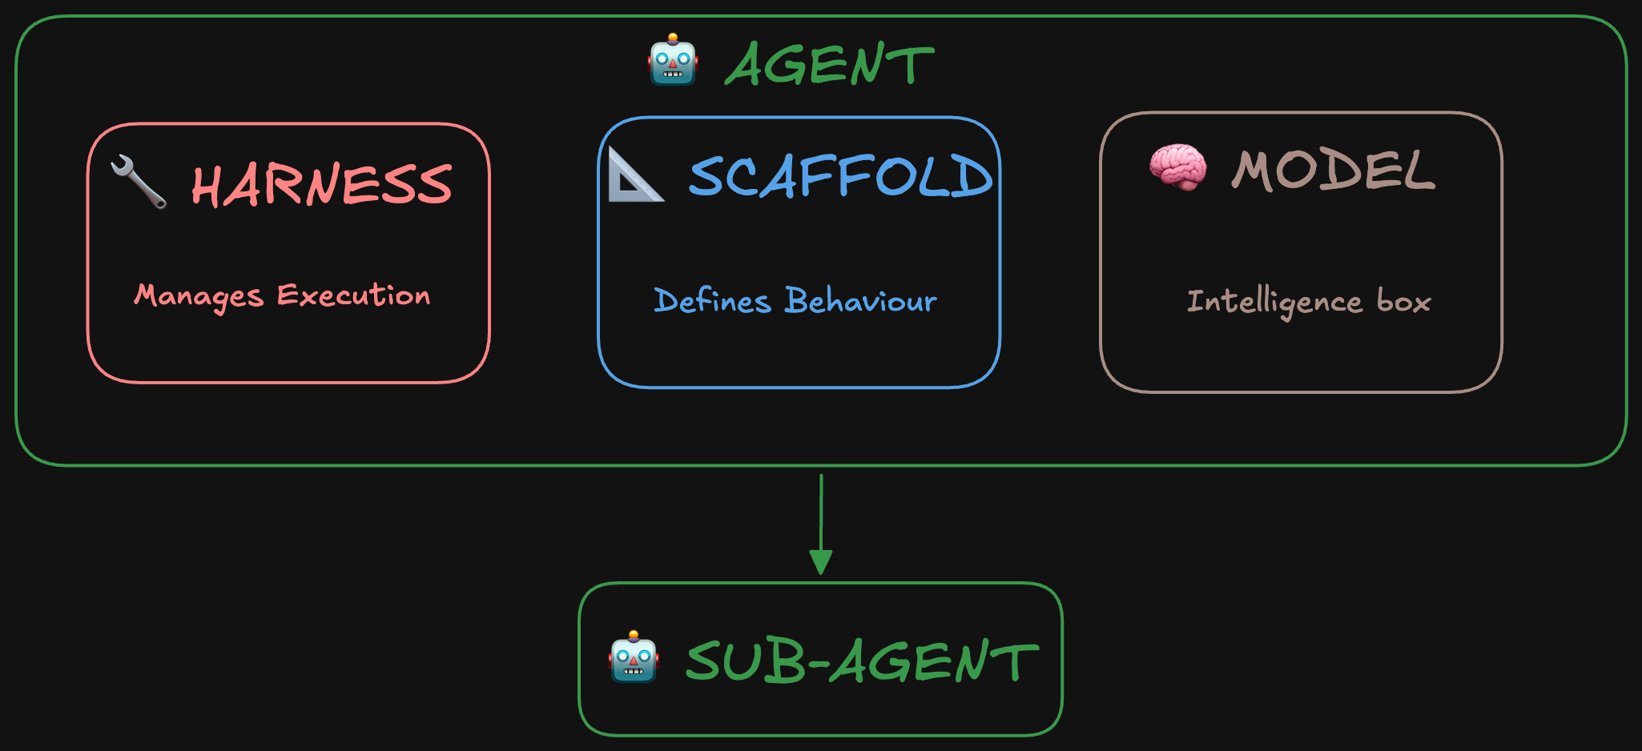
Harness engineering
Scaffolding: Behavior-defining layer around the model- system prompt, tool descriptions, how the model's responses get parsed, what it remembers across steps (context management). It shapes how the model sees the world and acts in it, whether during training or at inference.
Harness : Execution layer inside the agent: it calls the model, handles its tool calls, decides when to stop. The harness is what makes the agent run. Scaffolding what the model works from: its instructions, its tools, its format.
Harness engineering is the discipline of designing this layer well: deciding when the agent should stop, how errors get handled, and what guardrails keep it on track. It applies at both training and inference.
https://huggingface.co/blog/agent-glossary

Slide 25
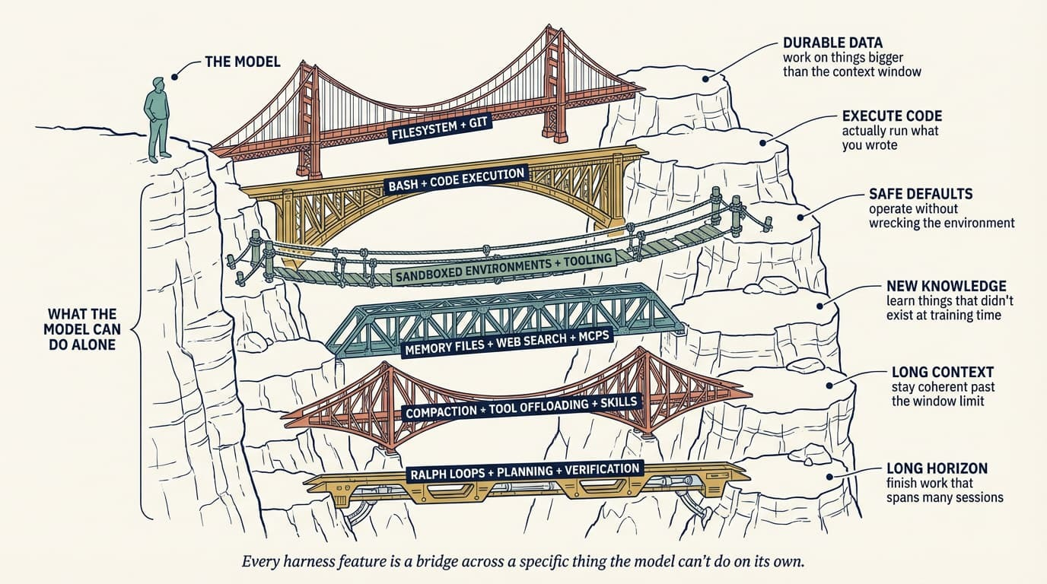
Harness engineering
https://www.oreilly.com/radar/agent-harness-engineering/

Slide 26
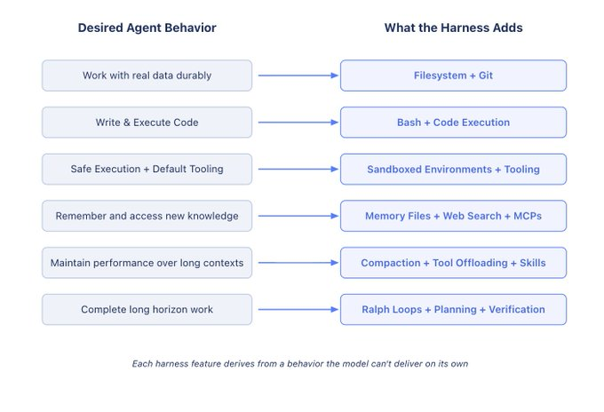
https://www.langchain.com/blog/the-anatomy-of-an-agent-harness

Slide 27
Four layers of engineering around an LLM
Layer | Core question | Analogy | Common failure modes | Example techniques
Prompt engineering | What do we say to the model? | Instruction manual | Ambiguous instructions, format drift, hallucination | Few-shot, chain-of-thought, structured output
Context engineering | What should the model see right now? | Working memory / RAM | Poisoning, distraction, confusion, clash | RAG, history compression, tool descriptions
Memory engineering | What should persist across sessions? | Long-term memory / disk | Irrelevant retrieval, stale memories, privacy leaks | AGENTS.md, vector stores, knowledge graphs
Harness engineering | How should the agent operate? | Operating system / kernel | premature completion, cascading errors, poor self-evaluation | Tools, sandbox, planning,

Slide 28
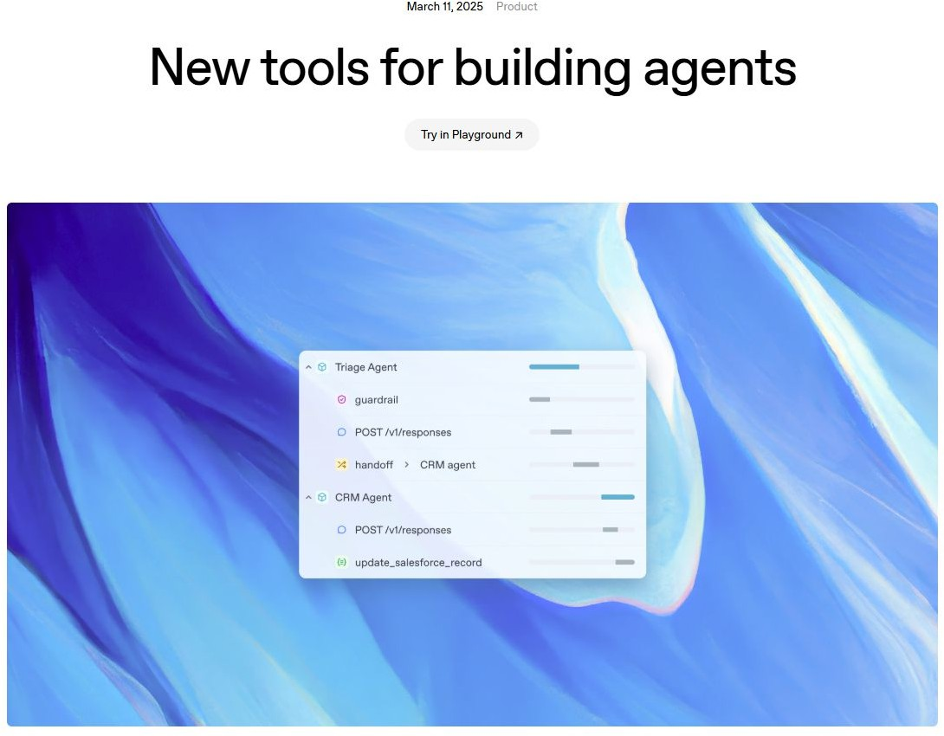
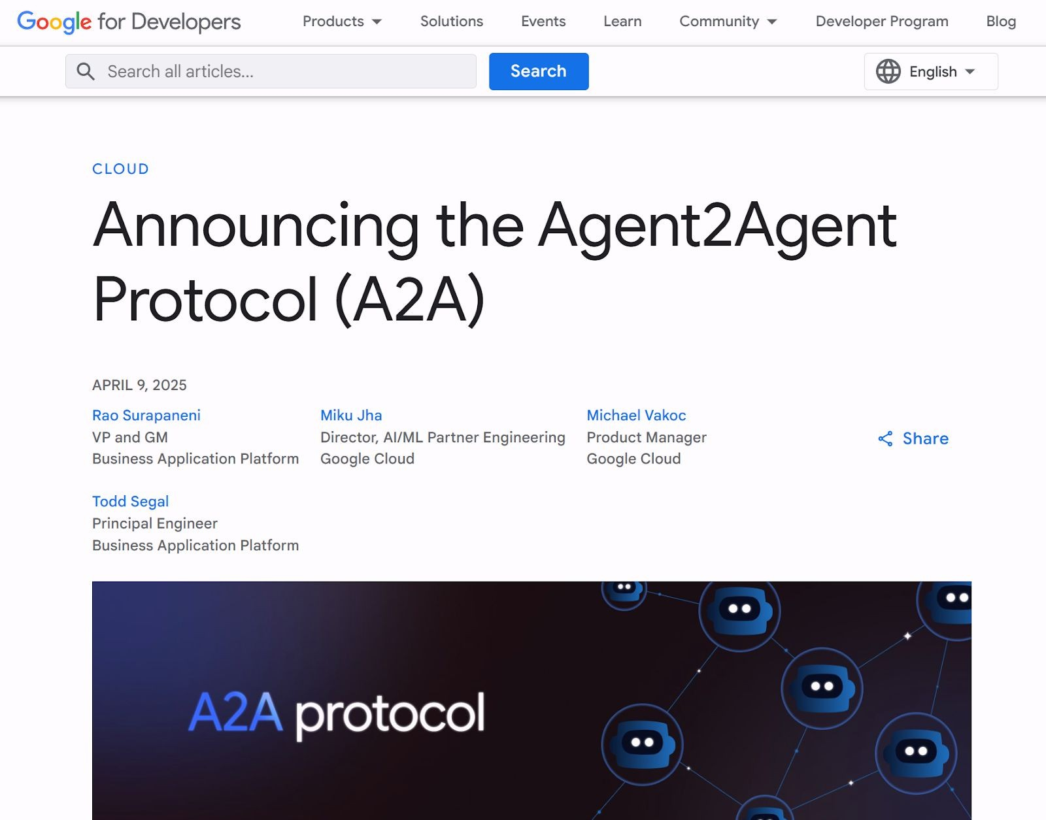
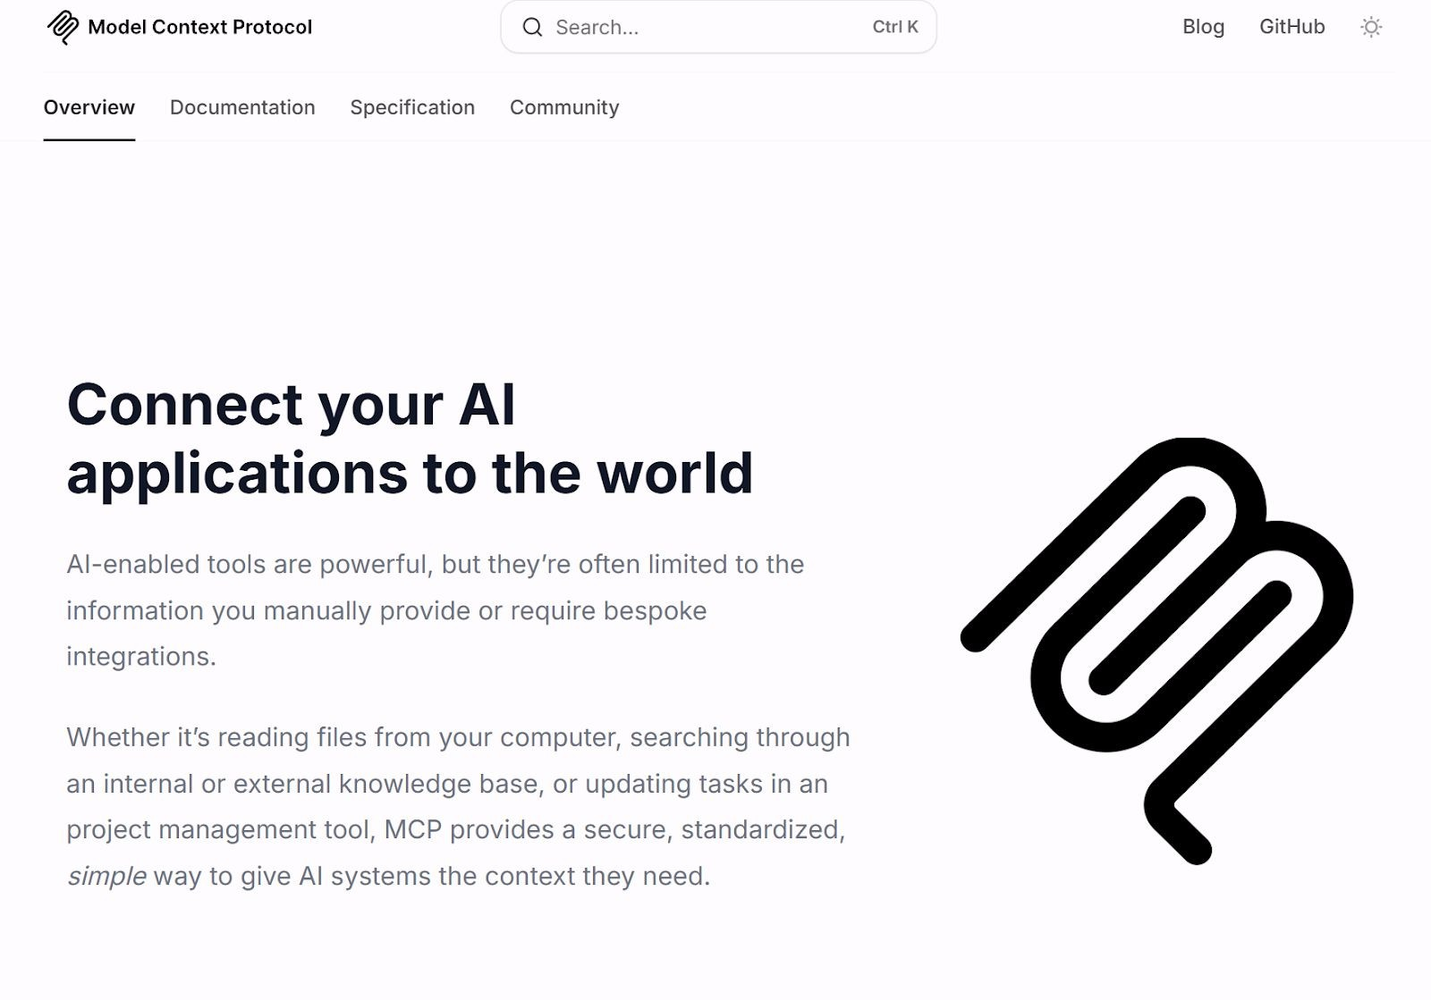
LLM Agent are evolving fast
Many agentic libraries, packages, and products
Open agent standards such as MCP for tool use, and A2A for task comm
Many proposed evaluations: AgentBench, WebArena, AgentDojo, …

Slide 29
Sample case study questions

Slide 30
Case Study 1: Customer Operations Assistant
HorizonBank is a mid-sized retail bank rolling out an AI-powered "Customer Operations Assistant" that its branch staff can use during customer calls. Different parts of the assistant serve different needs, and the architecture team must pick the right pattern for each.
The team has narrowed each need to one of four multi-agent patterns from the LangChain framework: Subagents, Skills, Handoffs, Router(with &without synthesis). For each of the problems below, Which pattern fits, and why?
A. Daily branch briefing
Every morning at 8:00 AM, each branch manager needs a one-page briefing that combines: (i) overnight transaction alerts from the fraud system, (ii) today's scheduled customer appointments from the calendar system, (iii) pending loan approvals from the CRM, and (iv) market news from an external feed. These four sources are independent, must be queried in parallel to meet the 8:00 AM deadline, and each has its own domain vocabulary and API. The briefing template is fixed — all four sources appear every morning regardless of content — so no per-request selection is needed.
Ans: Subagents
Fixed template — all four domains every morning, parallel, aggregated. No per-request selection.
"Rules out Router because the set of sub-systems is static and deterministic, not dynamically selected per request."

Slide 31
Case Study 1: Customer Operations Assistant
B. New customer onboarding
Opening an account requires a strictly sequential workflow — KYC document collection → identity verification → risk profiling → product recommendation → account activation. The customer is on the phone throughout, and each step's outcome determines the specifics of the next. The customer must experience it as one continuous conversation.
Ans: Handoffs
Sequential state transitions, one continuous user conversation, each step's output drives the next
C. Complaint intake and routing (1 mark)
Customer complaints arrive through a single chat channel but must reach the right specialist: card fraud, loan servicing, mortgage, or general banking. Only one specialist handles any given complaint, and the choice depends on classifying the complaint from the first message. There is no need to consult all four in parallel — one call, one destination.
Ans: Router
Classify once, dispatch to exactly one specialist, no parallelism, no synthesis

Slide 32
Case Study 1: Customer Operations Assistant
D. Personal banker for high-net-worth clients
The bank wants one virtual "personal banker" agent that can help with dozens of niche tasks — from explaining a specific structured product, to walking through an NRI remittance form, to filing a portfolio rebalancing request. Loading all of that expertise upfront would blow the context window, and most requests only touch one or two areas. Each expertise area is a self-contained procedure with its own instructions.
Ans: Skills
One agent, many possible specializations, progressive disclosure to protect the context window
E. Wealth-management research assistant
HorizonBank's private-banking arm wants an assistant for its relationship managers. Client questions can touch tax rules, mutual-fund performance, real-estate trends, or currency markets — often two or three of these at once, sometimes only one. The bank has a dedicated specialist agent for each of the four verticals. Loading all four experts on every question would be wasteful; picking exactly one would miss cross-domain questions like "how would selling my flat and moving the proceeds into equity funds change my tax position?" The assistant must decide per question which subset of specialists to consult, run them in parallel, and give the relationship manager one merged answer.
And: Router with Synthesis
Dynamic subset selection per request, selected experts run in parallel, results synthesised.

Slide 33
Case study 2: SupportBot
SupportBot is the AI agent that answers customer questions on ShopKart's website — an e-commerce store selling clothes and electronics. When a customer clicks the chat bubble in the corner, they're talking to SupportBot.
Who it works with - Two other bots on the same team:
    order-bot — looks up order status and delivery info in the orders database
    refund-bot — handles refund requests, checks eligibility, and issues them
    SupportBot is the front-facing coordinator. It talks to the customer, decides who should help, hands off to the specialist bot when needed, and reports back.
What SupportBot does day-to-day -Three jobs:
    Answers product questions — "Is this shirt machine washable?", "Does this laptop come with a charger?"
    Helps with orders — "Where is my order?", "I want to cancel my order", "I need a refund"
    Handles complaints — "The product arrived damaged", "The size doesn't fit“
A concrete scenario — Priya's conversation
    Priya messages SupportBot at 3 pm: "Hi, I ordered a blue shirt last week and it hasn't arrived yet. Also I wanted to know your return policy."

Slide 34
Case study 2: SupportBot
Step | What happens | Memory type in play
1 | SupportBot starts the conversation. It loads its rulebook: "always greet by name if known", "escalate to human after 3 failed attempts", "never promise a refund without checking eligibility". | Procedural (long-term)
2 | SupportBot holds Priya's message in its scratchpad along with what it plans to do: (a) check order, (b) answer return policy. | Working (short-term)
3 | Priya asked "what is your return policy?" — thousands of customers ask this in slightly different wording every day ("how do I return?", "can I get a refund?"). SupportBot already has this cached — instant answer, no LLM call needed. | Semantic cache (short-term)
4 | For the return policy answer itself, SupportBot pulls the current policy text from its indexed knowledge base of ShopKart's help docs. | Semantic long-term (knowledge base)

Slide 35
Case study 2: SupportBot
5 | SupportBot recognises Priya — she's a returning customer. It looks up her profile: "prefers Hindi, prefers concise answers, VIP tier (fast shipping)." Adjusts tone accordingly. | Semantic long-term (persona memory)
6 | SupportBot also knows the shirt she's asking about — "SKU 8842, blue cotton shirt, ships from Bengaluru warehouse." | Semantic long-term (entity memory)
7 | SupportBot recalls: "Priya messaged us three weeks ago about a delayed order; she was frustrated, we sent her a ₹200 voucher." Handles her carefully this time. | Episodic (long-term)
8 | SupportBot needs order details. It writes to a shared row: case[9931] = {customer: Priya, order: #4482, needs: order_status}. order-bot picks it up. | Shared memory (coordination)
9 | order-bot writes back to the same row: order_status: delayed, new_ETA: tomorrow, reason: warehouse_delay. SupportBot reads it and tells Priya. | Shared memory (coordination)

Slide 36
Case study 2: SupportBot
Memory type | Technology | What it stores in SupportBot
Working | LangGraph state / Redis | Priya's current message, SupportBot's plan for this turn
Semantic cache | GPTCache / Redis + vector search | "return policy?" and its 50 rewordings → one cached answer
Procedural | AGENTS.md file on disk | Rulebook: greet by name, escalate after 3 tries, never promise refunds
Episodic | pgvector | Priya's past conversations, tagged with date and sentiment
Semantic — knowledge | Qdrant / Pinecone | Help docs, FAQs, policies, product manuals
Semantic — entity | JSON / SQLite | Product catalogue: SKU, description, warehouse
Semantic — persona | JSON per customer | Priya: Hindi, concise, VIP tier
Shared | PostgreSQL | The case row that SupportBot, order-bot, refund-bot all read/write

Slide 37
References
https://www.mongodb.com/resources/basics/artificial-intelligence/
https://milvus.io/blog/harness-engineering-ai-agents.md
https://www.mongodb.com/resources/basics/artificial-intelligence/agent-memory
https://huggingface.co/blog/agent-glossary
https://www.langchain.com/blog/the-anatomy-of-an-agent-harness
https://www.langchain.com/blog/choosing-the-right-multi-agent-architecture
https://rdi.berkeley.edu/agentic-ai/f26
https://rdi.berkeley.edu/llm-agents/f25
https://cme295.stanford.edu/
Research Papers
    Cognitive Architectures for Language Agents
    FireAct: Toward Language Agent Fine-tuning
Meta-Harness: End-to-End Optimization of Model Harnesses

